Slide 1


Jenkins Continuous Integration
SDET Fundamental Training

Slide 2

Improving Your Productivity
Continuous integration can help you go faster
Detect build breaks sooner
Report failing tests more clearly
Make progress more visible

Slide 3

Jenkins Continuous Integration
Open source CI server
Jenkins (http://jenkins-ci.org/) is
Easy to install
Easy to use
Multi-technology
Multi-platform
Widely used
Extensible
Free

Slide 4

Jenkins for a Developer
Easy to install
Download one file – jenkins.war
Run one command – java –jar jenkins.war
Easy to use
Create a new job – checkout and build a small project
Checking a change – watch it build
Create a test – watch it build and run
Fix a test – checking and watch it pass
Multi-technology
Build C, Java, C#, Python, Perl, SQL, etc.
Test with Junit, Nunit, MSTest, etc.

Slide 5
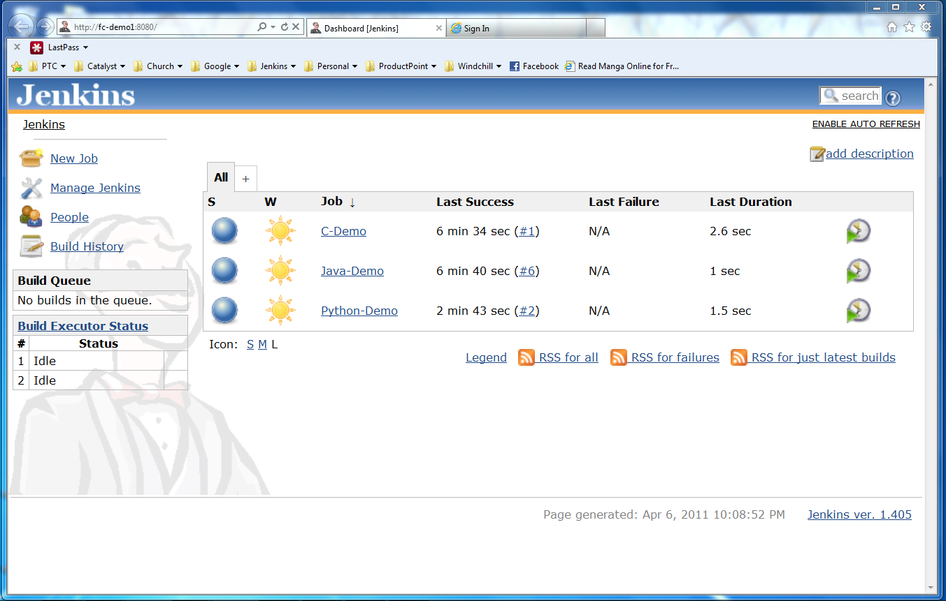
Actions
Nodes
Jobs

Slide 6
Developer demo goes here
Create a new job from a Subversion repository
Build that code, see build results
Run its tests, see test results
Make a change and watch it run through the system
Languages
Java
C
Python

Slide 7
More Power
Jenkins has over 300 plugins
Software configuration management
Builders
Test Frameworks
Virtual Machine Controllers
Notifiers
Static Analyzers

Slide 8
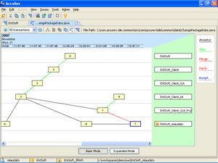

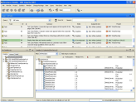


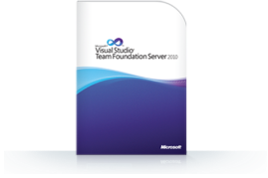

Plugins - SCM
Version Control Systems
Accurev
Bazaar
BitKeeper
ClearCase
Darcs
Dimensions
Git (Our Focus)
Harvest
MKS Integrity
PVCS
StarTeam
Subversion
Team Foundation Server
Visual SourceSafe

Slide 9
Plugins – Build & Test
Build Tools
Ant
Maven (Our Focus)
MSBuild
Cmake
Gradle
Grails
Scons
Groovy
Test Frameworks
Junit
Nunit
MSTest
Selenium
Fitnesse

Slide 10

Integration for You
Jenkins can help your development be
Faster
Safer
Easier
Smarter

